Slide 1








DDL, DML, DQL, DCL, TCL
Hands-on Exercise
Reference
Questions
Points To Ponder
Coding Standards
Lend A Hand
Summary
Test Your Understanding
2

Slide 2

OVERVIEW
The session on DDL, DML, DQL, DCL, TCL provides knowledge and understanding of the various database-centric operations with the help of a case study using ANSI SQL syntax.
3

Slide 3

OBJECTIVES
At the end of this session, you will be able to:
    Identify the various SQL operations that a developer needs to know to work with DBMS.
    Define DQL - Select Statements.
    Describe DML - Insert Statement, Update, and Delete Statement.
    Define TCL Statements.
    Recognize DDL - Create Table, Alter Table, Rename, Truncate, and Drop table.
    Define DCL Statements.
4

Slide 4
SCENARIO
For the complete understanding of ANSI SQL, we are going to make use of Product Management System (PMS) for ABC Traders.
ABC Traders is a company which buys collectable model cars, trains, trucks, buses, and ships directly from manufacturers and sell them to distributors across the globe. In order to manage the stocking, supply, and payment transactions, the above mentioned software is developed.
As per the requirement of the trading company, an inventory system is developed to collect the information of the products, customers, and their payment processing.
5

Slide 5
DATABASE TABLES
There are many entities involved in Product Management System.
We will be dealing with PMS throughout this session.
Offices
To maintain information of offices, for example, office code, address, city, and so on.
Customer
To maintain customer details, for example, customer name, address, and so on.
Products
To maintain information of products, for example, product id, name, and so on.
Employees
To maintain employee
details, for example, ID,
name, and so on.
Payments
To maintain information of payments done, for example, payment date, amount, and so on.
Orders
To maintain Orders done by customers, for example, order no, date, and so on.
Order Details
To maintain Orders done by customers, for example, order no, date, and so on.

Slide 6
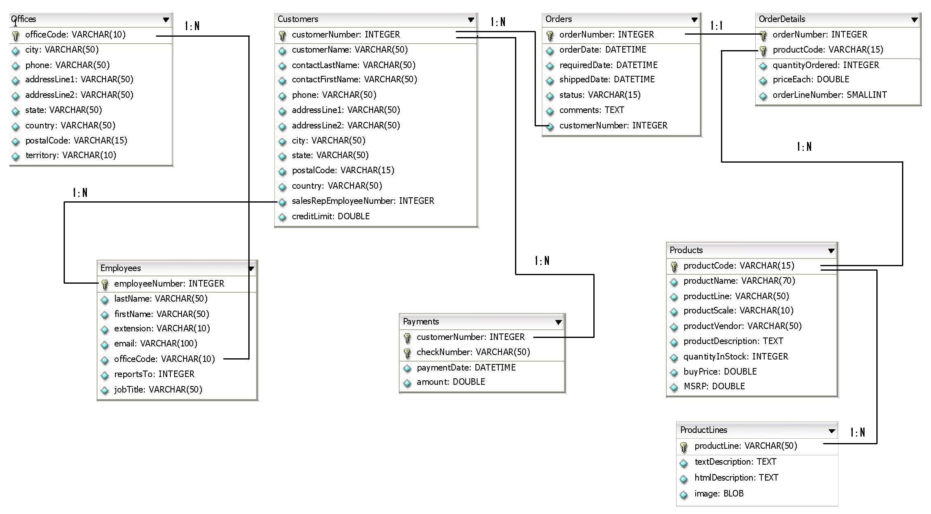
SCHEMA DIAGRAM
7

Slide 7


SCENARIO
Hi! I am Tim,
I am your customer. I have a set of requirements that needs to be fulfilled.
During this session, Tim will act as customer and you will act as a developer to fulfill the requirements of Tim.
You
will be one of the new database developers responsible to accomplish the project needs of Tim.
8

Slide 8

SCENARIO
Retrieve!
I wish to get last name, first name, and phone number of all customers of ABC Trader’s PMS System.
Let us learn about Data Query Language SELECT Statement which will help us meet Tim’s requirements.
9

Slide 9
SELECT STATEMENT
Query:
SELECT contactLastName, contactFirstName, phone
FROM Customers;
Explanation:
    The above query will display last name, first name, and contact number of all customers from Customers table.
    When you select specific columns from a table(relation), it is termed as PROJECTION operation in relational algebra.
Note:
    From now onwards, in any query, we will be using the following color conventions:
    BLUE To represent the keyword in ANSI SQL (should be written in CAPITAL)
    ORANGE To represent an identifier i.e. any name given by user
10

Slide 10
SCENARIO
Retrieve All!
I wish to get the complete data of all customers of PMS System.
Let’s learn about Data Query Language SELECT * Statement which will help us meet Tim’s requirements.
11

Slide 11
SELECT * STATEMENT
If you wish to select all columns from a table without specifying column names, you can try the below mentioned query.
Query:
SELECT *
FROM Customers;
Note: The above query is a bad practice. Never use it in a production environment on tables with huge number of rows.
Usually in projects we do not write query using SELECT *, rather we use SELECT COUNT(*) where COUNT() is a SQL function (to be learnt in another session) that returns the number of records in table.
Query:
SELECT COUNT(*)
FROM Customers;
    If the table comprises 122 rows, it will return 122 as a result which is just a scalar value.
12

Slide 12
SCENARIO
Retrieve Specific!
I wish to get last name, first name, and phone number of all customers who belong to Germany of PMS System.
Let’s learn about Data Query Language SELECT Statement’s WHERE clause which will help us meet Tim’s requirements.
13

Slide 13
SELECT STATEMENT’S WHERE CLAUSE
Query:
SELECT contactLastName, contactFirstName, phone
FROM Customers
WHERE country="Germany";
Explanation:
  The above query will display last name, first name, and contact number of all customers who belong to Germany from Customers table.
  When you select specific rows from a table(relation), it is termed as RESTRICTION operation in relational algebra.
14

Slide 14
SELECT SYNTAX
Retrieving data using SELECT statement is a common task which is done on a daily basis. The complete syntax of SELECT is given below.
SELECT
ANSI Syntax :
SELECT
[ ALL| DISTINCT] <COLUMN name>[[ AS] <alias>]
[,[ ALL| DISTINCT] <COLUMN name>[[ AS] <alias>]] *
FROM
<table>[[ AS] <alias>|[[ FULL| LEFT| RIGHT] OUTER| INNER] JOIN <table> ON <expression>]
[, <table>[[ AS] <alias>|[[ FULL| LEFT| RIGHT] OUTER| INNER] JOIN <table> ON <expression>]] *
[WHERE <predicate>[{ AND| OR} <predicate>]*]
[GROUP BY <COLUMN name>[, <COLUMN name>]*
[HAVING <predicate>[{ AND| OR} <predicate>]]*]]
[ORDER BY <COLUMN name>[ ASC| DESC][, <COLUMN name>[ ASC| DESC]]*]
[FETCH FIRST <count> ROWS ONLY]
15

Slide 15
SELECT SYNTAX (CONTD.)
The SELECT statement has many optional clauses:
  SELECT clause specifies columns to retrieve.
  FROM clause defines the table(s) that is used for the query. It can also join tables.
  WHERE clause influences the rows the query returns. It filters the rows applying predicates on it. A predicate specifies conditions that can be true or false.
  GROUP BY clause group rows sharing a property so that an aggregate function can be applied to each group.
  HAVING clause selects from the groups defined by the GROUP BY clause.
  ORDER BY clause specifies an order in which to return the rows.
Note: GROUP BY, HAVING, and ORDER BY clause will be discussed in upcoming sessions.
16

Slide 16
SCENARIO
Add Data!
I wish to perform record insertion in the Employee table of PMS system.
Let us learn about Data Manipulation Language INSERT Statement which will help us meet Tim’s requirements.
17

Slide 17
INSERT STATEMENT
INSERT
INSERT adds new rows into an existing table.
The INSERT ... VALUES and INSERT ... SET forms of the statement insert rows based on explicitly specified values.
The INSERT ... SELECT form inserts rows selected from another table or tables.
Query:
INSERT INTO EMPLOYEES VALUES
(1703,"Jones","Smith","x19200",
"sjones@classicmodelcars.com",4,1101,"Sales Rep");
Explanation:
  The above query will add a new employee named Smith Jones with id 1703, designation Sales Representative, who reports to employee 1101. His email id and extension are sjones@classicmodelcars.com and x19200, respectively.
Syntax :
INSERT [INTO] tbl_name [(col_name,...)] VALUES ({expr | DEFAULT},...)
18

Slide 18
SCENARIO
Add Bulk Data!
I wish to perform bulk record insertion in the Employee table of PMS system.
Let us learn about Data Manipulation Language INSERT Statement which will help us meet Tim’s requirements.
19

Slide 19
MULTI ROW INSERTS
You can insert multiple rows at a time with a single SQL statement using the command below.
Query :
  To insert multiple records in Employee table:
INSERT INTO EMPLOYEES VALUES
(1703,"Jones","Smith","x19200","sjones@classicmodelcars.com",4,1101,"Sales Rep"),
    (1704,“Demur",“Michel","x19200",“michelD@classicmodelcars.com",4,1102,"Sales Rep");
Syntax:
INSERT [INTO] tbl_name [(col_name,...)]
VALUES ('value-1a', ['value-1b', ...]),
('value-2a', ['value-2b', ...]),
('value-2a', ['value-2b', ...])
20

Slide 20
MULTI ROW INSERTS (CONTD.)
You can insert multiple rows at a time from one table to another, provided, the columns which are being copied are compatible with each other.
Query :
  To insert multiple records from the Employee table to the Employee_Copy table and retain the same structure, you can use the below query:
    INSERT INTO Employee_Copy
    SELECT * FROM Employee;
Syntax :
INSERT [INTO] tbl_name [(col_name,...)]
<SELECT Query>
21

Slide 21
SCENARIO
Oops!
In Employee Table, the extension for employee 1703 has been changed. But it still shows old data which needs to be updated.
Let us learn about Data Manipulation Language UPDATE Statement which will help us meet Tim’s requirements.
22

Slide 22
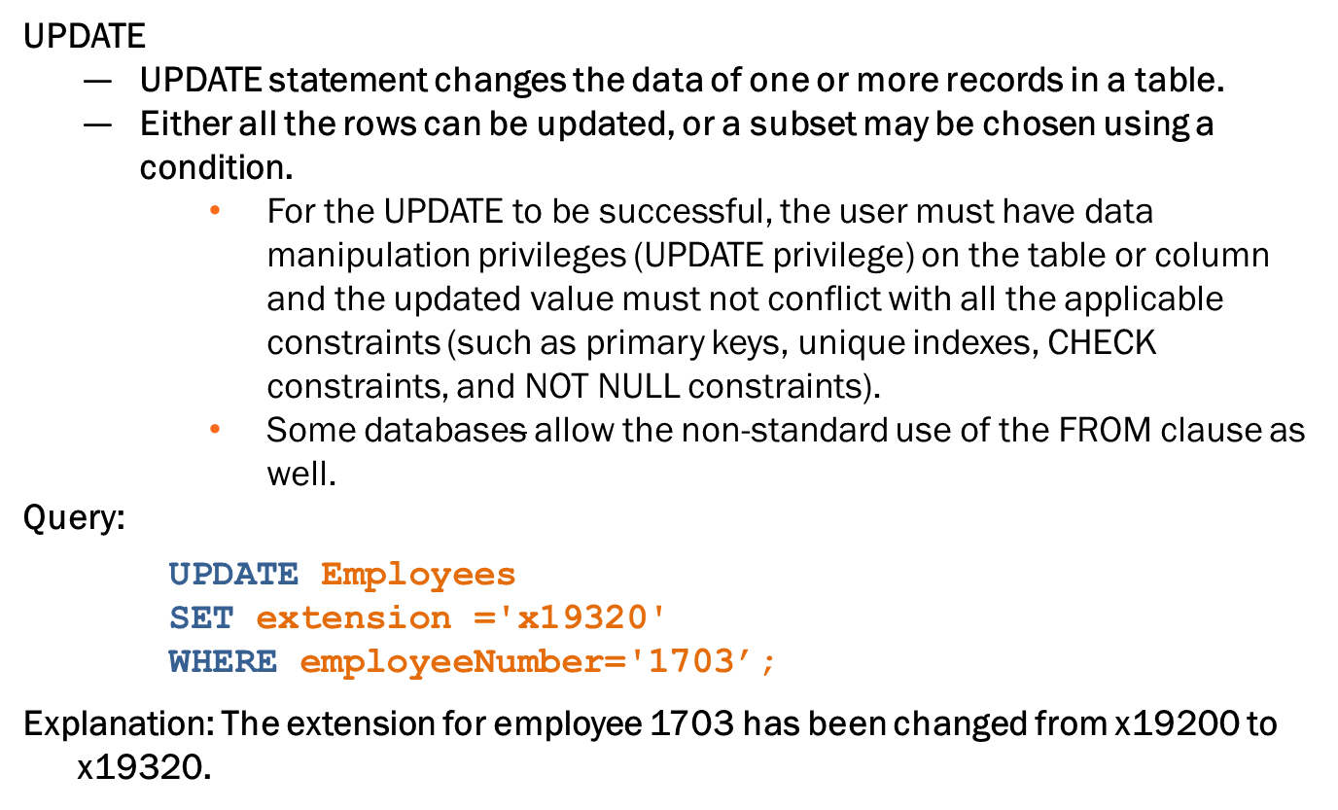
UPDATE STATEMENT
23

Slide 23
UPDATE STATEMENT (CONTD.)
Syntax:
UPDATE table_reference
SET
col_name1={expr1|DEFAULT}
[,col_name2={expr2|DEFAULT}] ...
[WHERE where_condition]
24

Slide 24
SCENARIO
Oops!
In Employee Table, the record of employee 1703 is no more required and needs to be removed.
Let’s learn about Data Manipulation Language DELETE Statement which will help us meet Tim’s requirements.
25

Slide 25
DATA MANIPULATION LANGUAGE
DELETE
DELETE statement removes one or more records from a table.
A subset may be defined for deletion using a condition, otherwise all records will be removed.
Some DBMSs, like MySQL, allow to delete rows from multiple tables with one DELETE statement (this is sometimes called multi-table DELETE).
Query:
    DELETE
    FROM Employees
    WHERE employeenumber=1703;
Explanation: The record of employee 1703 has been removed from employee table.
Syntax :
DELETE
FROM table_name
[WHERE condition];
26

Slide 26
SCENARIO
Undo!
While performing update or delete operation on Employee table, if certain mistakes happen, user must be able to retain previous state of data which was actually modified.
Let’s learn about Transaction Control Language COMMIT, ROLLBACK Statement which will help us meet Tim’s requirements.
27

Slide 27
TRANSACTION CONTROL LANGUAGE
A transaction is logical unit of work that comprises one or more SQL statements, usually a group of DML statements.
Sometimes, by mistake, users perform certain DML operations and later realize that they must undo the changes that happened.
Even user wish that, out of the DML operations they performed, if at a certain point, whatever was done was fine and after that point the changes made needs to be discarded.
To achieve such mechanism, user needs to understand the following three commands:
  COMMIT to complete the transaction by saving the database changes.
  SAVEPOINT to divide the transaction into smaller sections. It defines breakpoints for a transaction to allow partial rollbacks.
  ROLLBACK to undo all changes of a transaction.
28

Slide 28
TRANSACTION CONTROL LANGUAGE (CONTD.)
Query and Explanation:
  Check all records of Employees table
SELECT * FROM Employees;
  Start transaction mechanism using following command
START TRANSACTION;
  Delete employee 1621 (Nishi) from Employees table
DELETE FROM Employees WHERE employeeNumber='1621’;
  User found he/she is trying to delete the wrong employee and fires below command
ROLLBACK;
  Check all records of Employees table to see whether 1621 record still exists
    SELECT * FROM Employees;
If, in the above mentioned code, the first SELECT query returns n records, after the transaction is over, the last SELECT query will still return the same number of records.
N records
Retention of Database State
29

Slide 29
TCL COMMIT STATEMENT
COMMIT
A COMMIT is the making of a set of tentative changes permanent. The popular usage is at the end of a transaction.
The general format is to issue a BEGIN WORK statement, one or more SQL statements, and then the COMMIT statement.
Syntax :
COMMIT;
30

Slide 30
TCL SAVEPOINT STATEMENT
SAVEPOINT
  A SAVEPOINT is a way of implementing sub transactions (also known as nested transactions) within a RDBMS by indicating a point within a transaction that can be "rolled back to“, without affecting any work done in the transaction before the savepoint was created.
Syntax :
SAVEPOINT name ;
Multiple savepoints can exist within a single transaction. Savepoints are useful for implementing complex error recovery in database applications. If an error occurs in the midst of a multiple-statement transaction, the application might be able to recover from the error (by rolling back to a savepoint) without needing to abort the entire transaction.
31

Slide 31
TCL ROLLBACK STATEMENT
ROLLBACK :
It is an operation which returns the database to some previous state. Rollbacks are important for database integrity, because they mean that the database can be restored to a clean copy even after erroneous operations are performed.
They are crucial for recovering from database server crashes; by rolling back any transaction which was active at the time of the crash, the database can be restored to a consistent state.
Syntax :
ROLLBACK ;
32

Slide 32
TCL ROLLBACK STATEMENT (CONTD.)
The rollback feature is usually implemented with a transaction log, but can also be implemented via multiversion concurrency control.
ROLLBACK is a command that causes all data changes since the last BEGIN WORK, or START TRANSACTION to be discarded by the RDBMS, so that the state of the data is "rolled back" to the state it was before those changes were made.
A ROLLBACK statement will also release any existing savepoints that might be in use.
In most SQL dialects, ROLLBACKs are connection specific. This means that if two connections are made to the same database, a ROLLBACK made in one connection will not affect the other connection. This is vital for proper concurrency.
All changes made after a savepoint has been declared can be undone by issuing a ROLLBACK TO SAVEPOINT namecommand.
Issuing the commands ROLLBACK or COMMIT will also discard any savepoints created since the start of the main transaction.
33

Slide 33
SCENARIO
Create!
I want the database and table structure to be created for PMS System.
Let’s learn about Data Definition Language CREATE Statement which will help us meet Tim’s requirements.
34

Slide 34
DATA DEFINITION LANGUAGE
Creating database is a core task as it must signify the meaning of its existence. Tim needs to be told about the best practices which we will follow while naming database or database objects.
Great!
Use plain English, for example, XDSFFBUS (bad name)
Include an indication of the object type in the name , for example, TrainingFeedbackDB
Avoid using spaces, for example, Feedback System
Avoid names that will become outdated , for example, Database2012
Avoid using special characters/symbols , for example, Database@FMS
Avoid using numbers in names , for example, Database007
35

Slide 35
SCENARIO
I have now finalized a name for PMS database. I want it to be named as ABCTradersPMSDB.
Let’s learn about Data Definition Language CREATE DATABASE Statement which will help us meet Tim’s requirements.
36

Slide 36
CREATE DATABASE
CREATE DATABASE
  This command is used to create database which is the primary part of any database system.
  Database will hold various database objects, for example, table, views etc.
Query :
  The following command is used to create database with the name “TrainingFeedbackDB”.
CREATE DATABASE ABCTradersPMSDB;
Syntax :
CREATE {DATABASE | SCHEMA} db_name
CREATE {DATABASE | SCHEMA} [IF NOT EXISTS] db_name [create_specification] ...
37

Slide 37
SCENARIO
I want to create a table with the name PMSOffices.
Let’s learn about Data Definition Language CREATE TABLE Statement which will help us meet Tim’s requirements.
38

Slide 38
CREATE TABLE
CREATE TABLE
  CREATE TABLE creates a table with the given name.
  You must have CREATE permission(called privilege) for the table.
  The table name can be specified as db_name.tbl_name to create the table in a specific database. This works regardless of a default database, assuming that the database exists.
Query :
    CREATE TABLE PMSOffices
    (
    officeCode VARCHAR(10) ,
    city VARCHAR(50) ,
    phone VARCHAR(50) ,
    addressLine1 VARCHAR(50) ,
    addressLine2 VARCHAR(50) ,
    state VARCHAR(50),
    country VARCHAR(50) ,
    postalCode VARCHAR(15)
    )
39

Slide 39
CREATE TABLE (CONTD.)
Syntax :
CREATE [TEMPORARY] TABLE [IF NOT EXISTS] tbl_name
(create_definition,...)
[table_options]
[partition_options]
[select_statement]
40

Slide 40
SCENARIO
Oops!
I forgot to mention column territory in the table PMSOffices.
Please add it.
Let’s learn about Data Definition Language ALTER TABLE Statement which will help us meet Tim’s requirements.
41

Slide 41
ALTER TABLE
ALTER TABLE
  ALTER TABLE changes the structure of a table.
  You can add or delete columns, create or destroy indexes, change the type of existing columns, or rename columns or the table itself.
Example :
  To add column territory in table PMSOffices:
ALTER TABLE PMSOffices ADD COLUMN territory VARCHAR(10);
ANSI Syntax :
ALTER TABLE tbl_name [alter_specification [, alter_specification] ...]
42

Slide 42
SCENARIO
Oops!
Can you change the table name PMSOffices to Offices ?
Let’s learn about Data Definition Language RENAME Statement which will help us meet Tim’s requirements.
43

Slide 43
RENAME TABLE
RENAME TABLE
  This statement renames one or more tables.
  The rename operation is done automatically, which means that no other session can access any of the tables while the rename is running.
Query:
  Command to change table name from PMSOffices to Offices:
RENAME TABLE PMSOffices TO Offices;
Syntax :
RENAME TABLE tbl_name TO new_tbl_name
44

Slide 44

RENAME TABLE (CONTD.)
If you have an existing table old_table, you can create another table new_table that has the same structure but is empty, and then replace the existing table with the empty one as follows (assuming that backup_table does not already exist):
If the statement renames more than one table, renaming operations are done from left to right. If you want to swap two table names, you can do so like this (assuming that tmp_table does not already exist):
As long as two databases are on the same file system, you can use RENAME TABLE to move a table from one database to another:
45

Slide 45
SCENARIO
Clean!
I want to remove PMSOffices table completely from database.
Let’s learn about Data Definition Language DROP/TRUNCATE Statement which will help us meet Tim’s requirements.
46

Slide 46
DROP TABLE
DROP TABLE
  DROP TABLE removes one or more tables.
  You must have the DROP privilege for each table.
  All table data and the table definition are removed when the table is dropped.
Query:
DROP TABLE PMSOffices;
Syntax:
DROP TABLE tbl_name [RESTRICT | CASCADE]
47

Slide 47
TRUNCATE TABLE
TRUNCATE TABLE
  TRUNCATE TABLE empties a table completely.
  It requires the DROP privilege.
  Logically, TRUNCATE TABLE is similar to a DELETE statement that deletes all rows, or a sequence of DROP TABLE and CREATE TABLE statements .
  TRUNCATE is faster and does not use as much undo space as a DELETE.
Query:
TRUNCATE TABLE PMSOffices;
Syntax :
TRUNCATE [TABLE] tbl_name
48

Slide 48
SCENARIO
Security!
Restrict users from performing various DB operations, to make DB more secure.
Create user Jack with password ‘pass@123’ who must be granted CREATE privilege so that he can create database.
Let’s learn about Data Control Language GRANT Statement which will help us meet Tim’s requirements.
49

Slide 49
DATA CONTROL LANGUAGE
Query:
  Creating User jack with Password ‘pass@123’
    CREATE USER jack IDENTIFIED BY 'pass@123' ;
  Granting Jack CREATE permission
    GRANT CREATE ON *.* TO 'jack';
  After Jack logs in using his credentials, let him CREATE a database
    CREATE Database TrainingFeedbackDBTemp;
Note:
  If required, the permission can be taken back from jack in future .
  Command to take away CREATE permission from jack
    REVOKE CREATE ON *.* FROM 'jack';
50

Slide 50
DATA CONTROL LANGUAGE (CONTD.)
The following commands are used to control access to data stored in a database:
  GRANT to allow specific users to perform specific tasks
  REVOKE to cancel previously granted or denied permissions
GRANT
ANSI Syntax:
REVOKE
ANSI Syntax:
GRANT privilege_name
ON object_name
TO {user_name |PUBLIC |role_name}
[WITH GRANT OPTION];
REVOKE privilege_name
ON object_name
FROM {user_name |PUBLIC |role_name}
  To use the first REVOKE syntax, you must have the GRANT OPTION privilege and you must have the privileges that you are revoking.
  REVOKE removes privileges, but does not drop table entries. To remove a user account entirely, use DROP USER or DELETE.
  You must create user first in order to grant or revoke privileges from them.
51

Slide 51
QUESTIONS
52

Slide 52
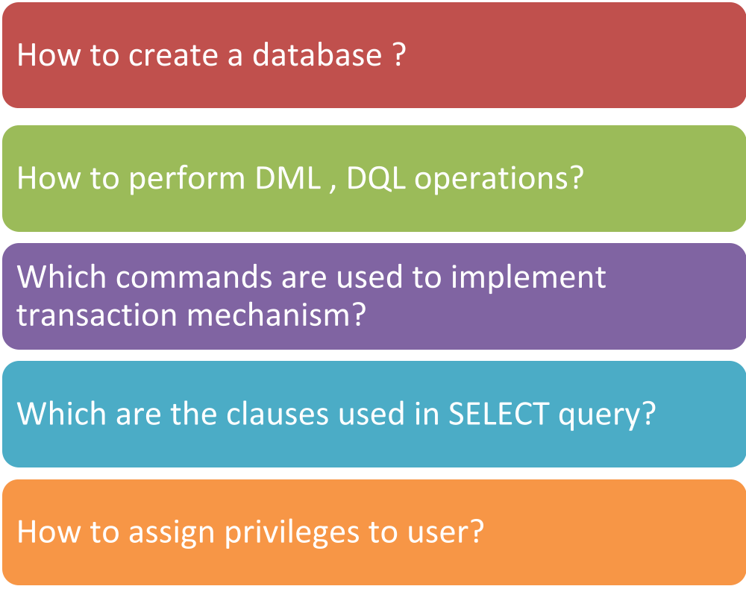

CHECK YOUR UNDERSTANDING
53

Slide 53
ACTIVITY
Now that we are well versed with commands, let’s test our understanding using a short case study.
Course Management System (CMS) ABC University
Case Study Scenario:
  This case study is to develop a Course Management System (CMS) for ABC University. The following are the two use cases for which the database needs to be designed.
  Add Course
  To add the course details into the course management system.
  Retrieve Course
  Retrieve the courses stored in the system and display them.
  The courses to be added will have the following attributes course code, course name, number of participants, course description, course duration, course start date, and course type.
54

Slide 54
LEND A HAND
Let’s develop the first table for our ABC university CMS system. We can create the table for storing the course details.
Let’s create a table named “COURSE_INFO” with the columns named column name, data type, and data size.
Column Name | Data Type | Data Size
COURSE_Code | Int
COURSE | Varchar | 20
COURSE_DESCRIPTION | Varchar | 20
COURSE_START_DATE | Date
55

Slide 55
LEND A HAND (CONTD.)
ABC university has come up with new requirements which require changes in the COURSE_INFO table we created.
Requirement # 1: The course code can be alpha numeric. Change the course code data type from int to varchar.
Requirement # 2: Course description can have 200 characters. Change the course description data size from 20 to 200.
Requirement # 3: Course detail should capture three additional details
  Course_Duration – int
  Number_of_Participants – int
  Course_Type- Character(3)
Requirement # 4: Rename COURSE column as COURSE_NAME.
57

Slide 56
LEND A HAND (CONTD.)
Requirement # 5: ABC University architects have defined a standard to precede all the tables in the database with string “CMS_”. Rename the table from COURSE_INFO to CMS_COURSE_INFO.
Requirement # 6: ABC University decides to break the CMS_COURSE_INFO table into multiple small tables. Delete all the records in the table and drop the table from the database.
58

Slide 57
LEND A HAND (CONTD.)
Let us insert the following four records into the “COURSE_INFO” table that we have already created.
Note: If the table is not there, please recreate the table.
COURSE_CODE | COURSE_NAME | COURSE_DESCRIPTION | COURSE_START_DATE
343 | Java Programming | Basics of Java | 12 /12/2012
167 | C Programming | Basics of C | 11/11/2012
347 | RDBMS | Basics Of RDBMS
106 | Oracle | Oracle SQL | 11/03/2011
61

Slide 58
LEND A HAND (CONTD.)
Requirement 7: Change the Course name from “Oracle” to “MYSQL” and Description to “MySQL” for the course with code 106.
Requirement 8: Remove the course RDBMS from the table.
COURSE_CODE | COURSE_NAME | COURSE_DESCRIPTION | COURSE_START_DATE
343 | Java Programming | Basics of Java | 12 /12/2012
167 | C Programming | Basics of C | 11/11/2012
347 | RDBMS | Basics Of RDBMS
106 | Oracle | Oracle SQL | 11/03/2011
62

Slide 59
LEND A HAND (CONTD.)
  Let’s practice using select queries.
  Requirement 9: Insert few more records in the course_info table. The green ones are newly inserted data. Check whether all the rows can be inserted successfully.
COURSE_CODE | COURSE_NAME | COURSE_DESCRIPTION | COURSE_START_DATE
343 | Java Programming | Basics of Java | 12 /12/2012
167 | C Programming | Basics of C | 11/11/2012
106 | MYSQL | My SQL | 11/03/2011
106 | Oracle | Oracle PL SQL | 11/03/2011
302 | Oracle | Oracle Architecture | 11/04/2011
231 | Core Java | Java IO | 11/06/2011
  Requirement 10: Retrieve courses named “Core Java”.
  Requirement 11: Retrieve courses named “Core Java” with the code 343.
  Requirement 12: Retrieve the unique course names of the courses.
64

Slide 60


SUMMARY
The key points covered in this session are:
  CREATE, ALTER, RENAME, and TRUNCATE are special commands
  How to insert, update, and delete records from table
  The division of commands
  How to grant and revoke privileges to users
66

